Slide 1
Code Smells Developing Design Sense for your Code
@LlewellynFalco

Slide 2
Play along at
Slides:
llewellynfalco.blogspot.com/p/sparrow-decks.html
Phone game:
bit.ly/sparrowdecks

Slide 3
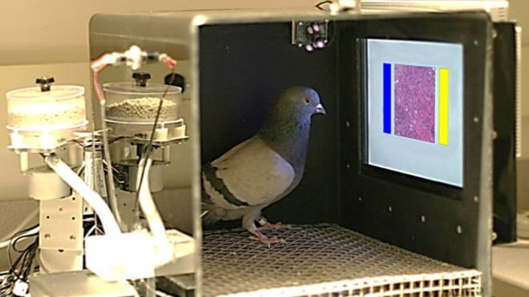
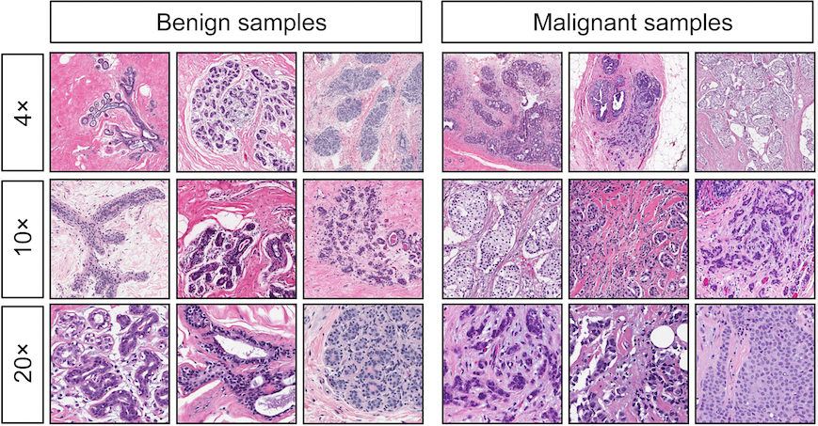
Dr. Pigeon diagnosis cancer
15 days of training
85% successful
University of Iowa
*http://journals.plos.org/plosone/article?id=10.1371/journal.pone.0141357

Slide 4
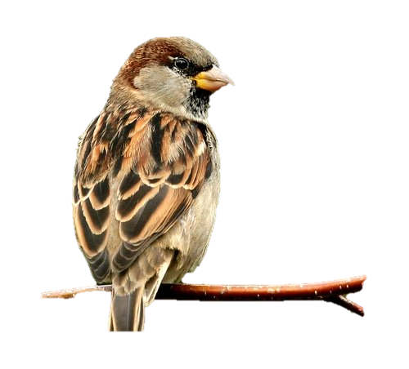
Sparrows Decks

Slide 5




Sparrows Decks
Song
House

Slide 6
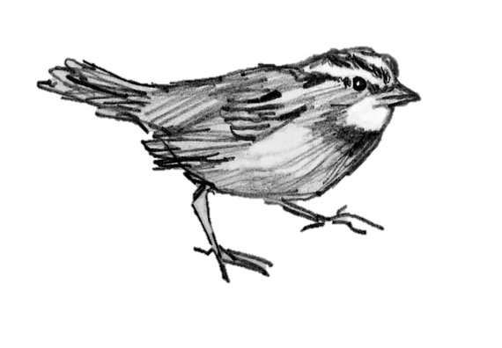
Sparrows Decks

Slide 7
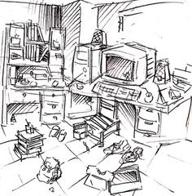
Clutter

Slide 8
bit.ly/sparrowdecks

Slide 9
Time to find things

Slide 10










Slide 11
Patterns in the code

Slide 13
Accounts_Receivable Balance_Sheet Cost_of_Goods Expenses Liabilities_2010 Present_Value Profit_And_Loss Outstanding_Invoices
Accounts_Receivable_2010 Balance_Sheet_2010 Cost_of_Goods_2010 Expenses_2010 Liabilities
Present_Value_2010 Profit_And_Loss_2010 Outstanding_Invoices_2010
Accounts_Receivable_2010 Balance_Sheet_2010 Cost_of_Goods_2010 Expenses_2010 Liabilities Present_Value_2010 Profit_And_Loss_2010 Outstanding_Invoices_2010

Slide 14
Long lines
if (fullName.StartsWith(hintAssemblyName, StringComparison.OrdinalIgnoreCase)
&& stream != null && BrowserInteropHelper.IsBrowserHosted || (loadedAssembly.FullName.Starts

Slide 15
Encapsulation & Readability

Slide 16
vs.
if (fullName.StartsWith(hintAssemblyName, StringComparison.OrdinalIgnoreCase)
&& stream != null && BrowserInteropHelper.IsBrowserHosted || (loadedAssembly.FullName.Starts
if (isAssemblyAvailable())

Slide 17
Long Methods
// If a license key has been located...
if (licenseKey != null) {
// Decrypt
licenseKey = ActiproLicenseProvider.DecryptString(licenseKey, encryptionKey);
// Find the licensee and license key
string[] licenseKeyData = licenseKey.Split(new Char[] { ';' });
if (BrowserInteropHelper.IsBrowserHosted) {
// XBAP licensing uses required assembly / licensee / license key
// Ensure that the specified assembly is in the AppDomain
string requiredAssemblyName = licenseKeyData[0].Trim();
Assembly[] assemblies = AppDomain.CurrentDomain.GetAssemblies();
bool assemblyFound = false;
foreach (Assembly loadedAssembly in assemblies) {
if (loadedAssembly.FullName.StartsWith(requiredAssemblyName + ",", StringCompari
assemblyFound = true;
break;
}
}
if ((assemblyFound) && (plainTextLicensee == licenseKeyData[2]) && (String.Compare
// Assembly was found so use license data
licensee = licenseKeyData[2];
licenseKey = licenseKeyData[1];
sourceLocation = ActiproLicenseSourceLocation.AssemblySavedContext;
}
}
else {
// Regular licensing just uses licensee / license key
licensee = licenseKeyData[1];
licenseKey = licenseKeyData[0];
sourceLocation = ActiproLicenseSourceLocation.AssemblySavedContext;
}

Slide 18
Encapsulation & Readability

Slide 19
Merge Conflict

Slide 20
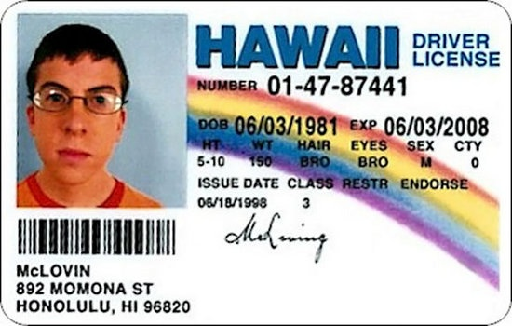
Bad Names

Slide 21
Time to Onboard New Employees

Slide 22
Silo’s

Slide 23
Lingo

Slide 24
The 7 stages of naming
By ArloBelshee
Nonsense
Honest
Honest &
Complete
Does the
Right Thing
Intent
Domain
Abstraction
Missing
Start
Structural
Refactoring
ParseXml
AndStoreFlight
ToDatabase
AndLocalCache
AndStart
Processing()
DoSomething
EvilTo
Database()
Begin
Tracking
Flight()
Monitoring
Panel
.Add(flight)
Foo()
StoreFlight
ToDatabase
AndStart
Processing()

Slide 25
The 7 stages of naming
Nonsense
Missing
// If a license key has been located...
if (licenseKey != null) {
// Decrypt
licenseKey = ActiproLicenseProvider.DecryptString(licenseKey, encryptionKey);
// Find the licensee and license key
string[] licenseKeyData = licenseKey.Split(new Char[] { ';' });
if (BrowserInteropHelper.IsBrowserHosted) {
// XBAP licensing uses required assembly / licensee / license key
// Ensure that the specified assembly is in the AppDomain
string requiredAssemblyName = licenseKeyData[0].Trim();
Assembly[] assemblies = AppDomain.CurrentDomain.GetAssemblies();
bool assemblyFound = false;
foreach (Assembly loadedAssembly in assemblies) {
if (loadedAssembly.FullName.StartsWith(requiredAssemblyName + ",", StringCompari
assemblyFound = true;
break;
}
}
if ((assemblyFound) && (plainTextLicensee == licenseKeyData[2]) && (String.Compare
// Assembly was found so use license data
licensee = licenseKeyData[2];
licenseKey = licenseKeyData[1];
sourceLocation = ActiproLicenseSourceLocation.AssemblySavedContext;
}
}
else {
// Regular licensing just uses licensee / license key
licensee = licenseKeyData[1];
licenseKey = licenseKeyData[0];
sourceLocation = ActiproLicenseSourceLocation.AssemblySavedContext;
}
Foo()

Slide 26
The 7 stages of naming
Nonsense
Honest
DoSomething
EvilTo
Database()
Foo()

Slide 27
The 7 stages of naming
ParseXml
AndStoreFlight
ToDatabase
AndLocalCache
AndStart
Processing()
Honest
Honest &
Complete
DoSomething
EvilTo
Database()

Slide 28
The 7 stages of naming
Honest &
Complete
Does the
Right Thing
ParseXml
AndStoreFlight
ToDatabase
AndLocalCache
AndStart
Processing()
StoreFlight
ToDatabase
AndStart
Processing()
Start
Structural
Refactoring

Slide 29
The 7 stages of naming
Does the
Right Thing
Intent
StoreFlight
ToDatabase
AndStart
Processing()
Begin
Tracking
Flight()

Slide 30
The 7 stages of naming
Intent
Domain
Abstraction
Begin
Tracking
Flight()
Monitoring
Panel
.Add(flight)

Slide 31
The 7 stages of naming
By ArloBelshee
Nonsense
Honest
Honest &
Complete
Does the
Right Thing
Intent
Domain
Abstraction
Missing
Start
Structural
Refactoring
ParseXml
AndStoreFlight
ToDatabase
AndLocalCache
AndStart
Processing()
DoSomething
EvilTo
Database()
Begin
Tracking
Flight()
Monitoring
Panel
.Add(flight)
Foo()
StoreFlight
ToDatabase
AndStart
Processing()

Slide 32
Duplication Duplication Duplication Duplication Duplication Duplication Duplication Duplication Duplication

Slide 33

Inconsistency

Slide 34
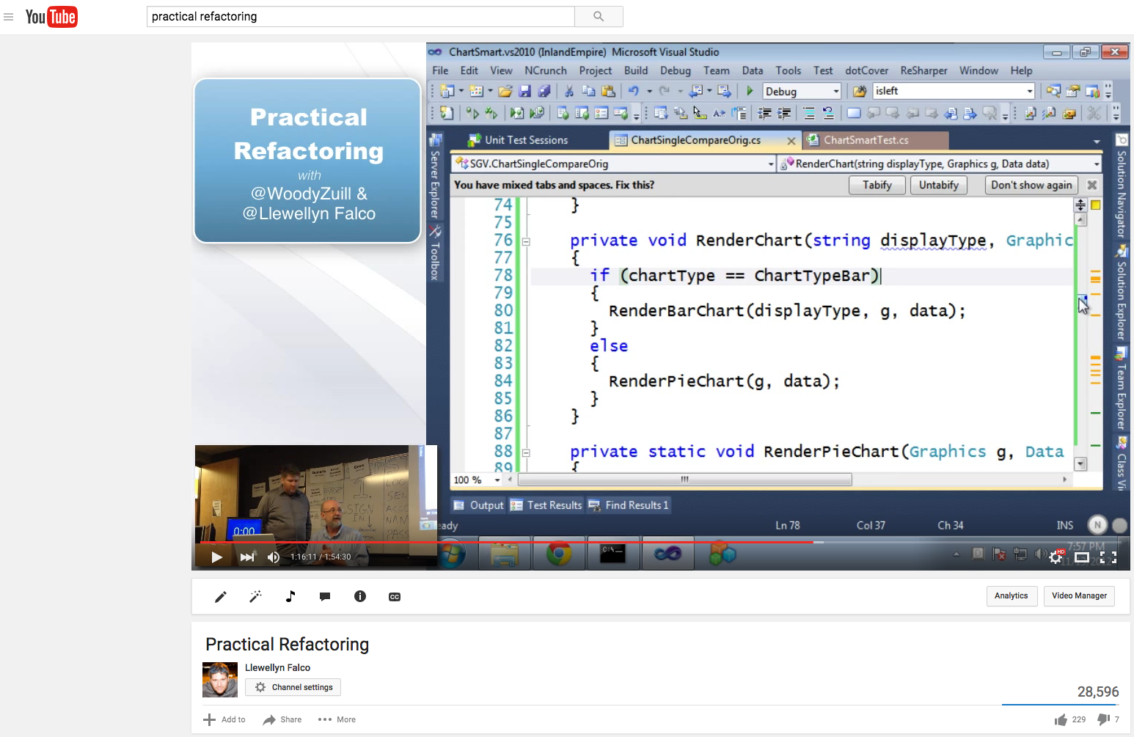

Slide 35
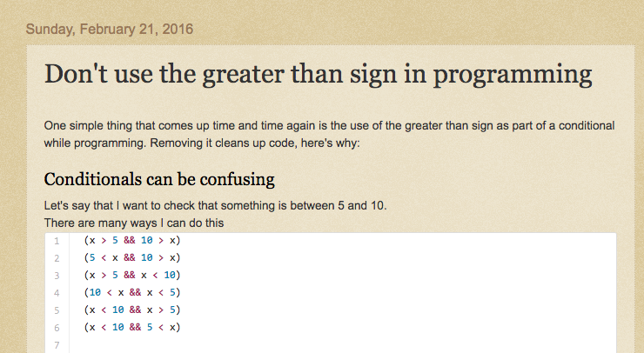
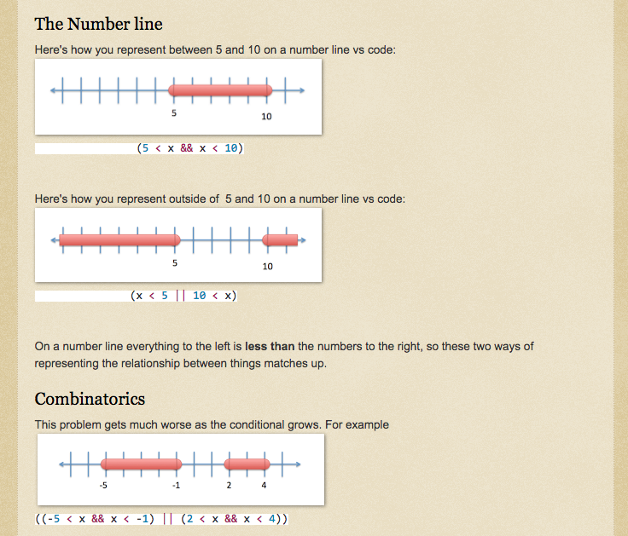
LlewellynFalco.blogspot.com

Slide 36
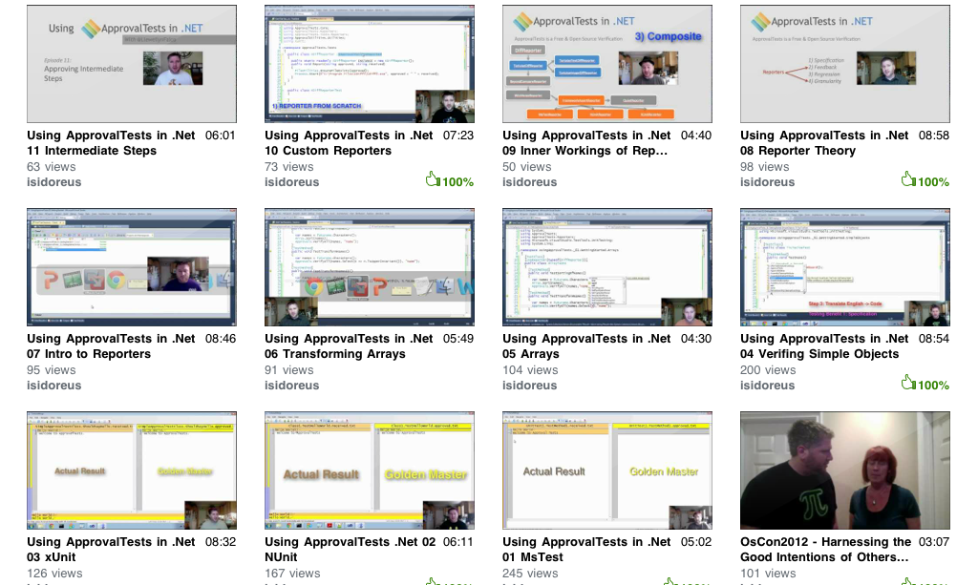
Resources
www.ApprovalTests.com
21 episode youtube series
Notes:
Both

Slide 37
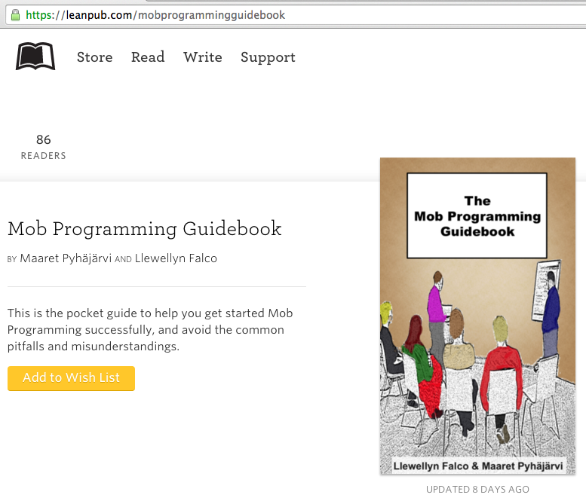
#MobProgrammingGuidebook

Slide 38

Contact Information
@LlewellynFalco http://LlewellynFalco.Blogspot.com
http://www.approvaltests.com
Notes:
Both

